Slide 1
Autonomous
Agriculture
Rover
IMPLEMENTATION & TESTING
Prototype Development Phase
PROJECT PHASE 2 — MARCH 2026
Student Names:
Abhimanyu Singh Rajawat
Shiven Choksi
Trishta Soam
Yogesh Tiwari
Nikhil Solanki
Internal Guide: Prof. Deep Paun
INDUS INSTITUTE OF TECHNOLOGY AND ENGINEERING

Slide 2
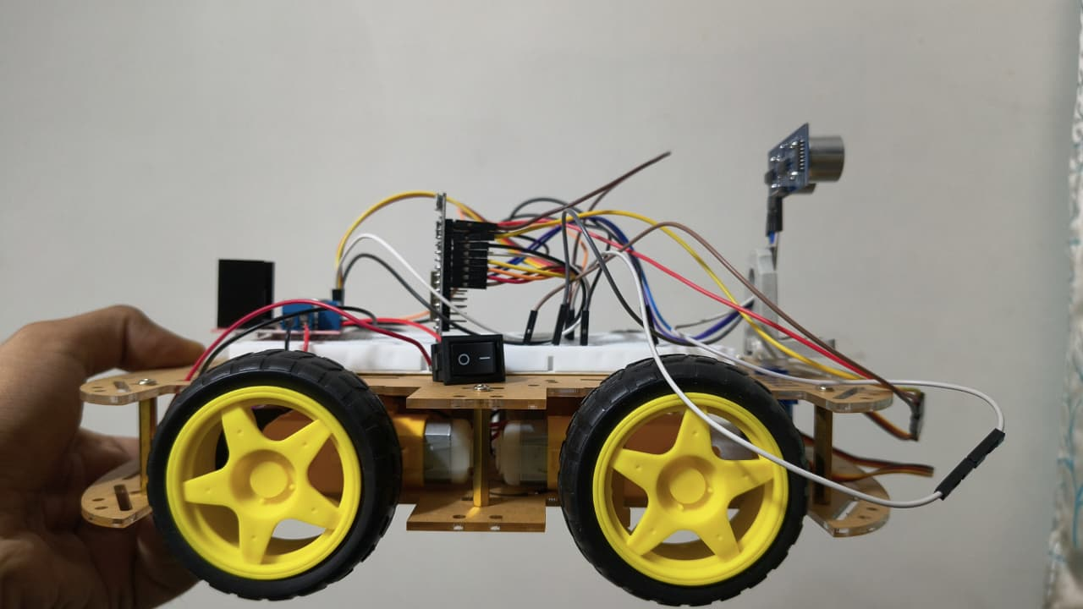
Phase 2 Objective
Convert design into a working functional prototype
Implement autonomous navigation using sensors
Integrate hardware and software components together
Test system functionality under real conditions

Slide 3
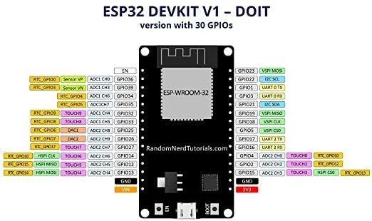
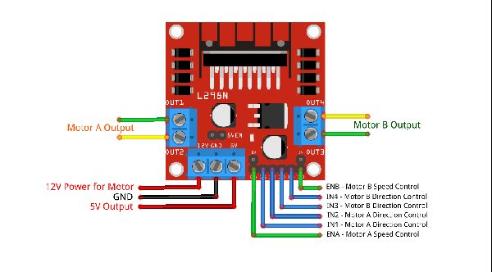
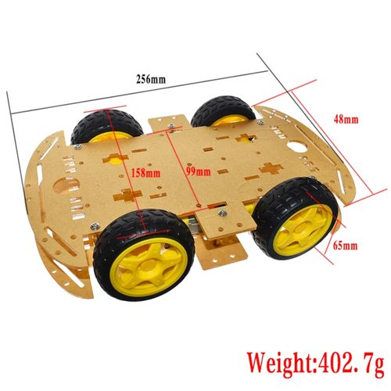
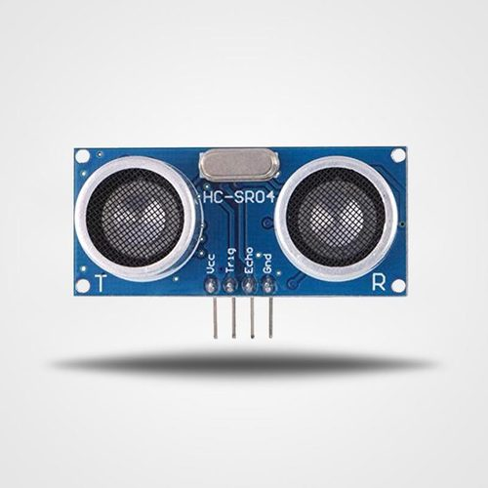
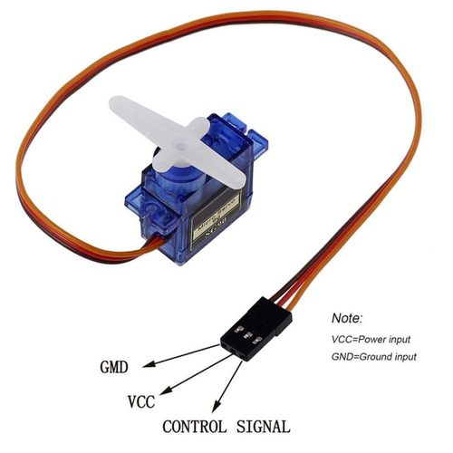
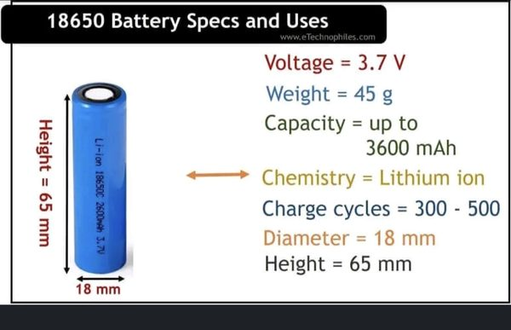
Hardware Procurement
ESP32 DevKit V1
L298N Motor Driver
4WD Chassis
HC-SR04 Ultrasonic
SG90 Servo Motor
18650 Battery

Slide 4
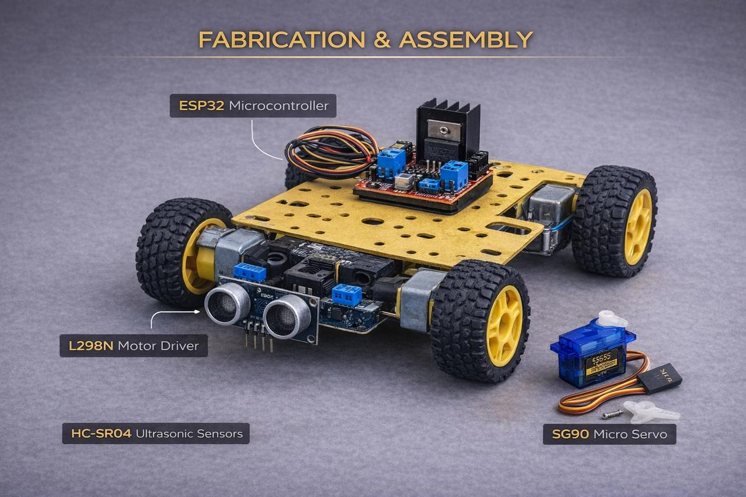
Fabrication & Assembly
Chassis fully assembled properly
Motors connected with driver
ESP32 mounted securely
Sensors placed at front
Power system integrated properly

Slide 5
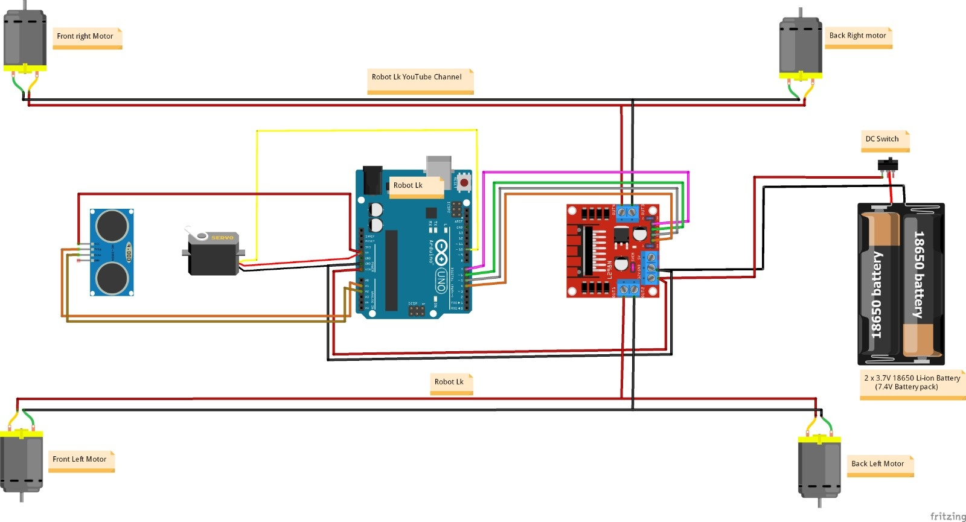
Circuit & Wiring Diagram

Slide 6
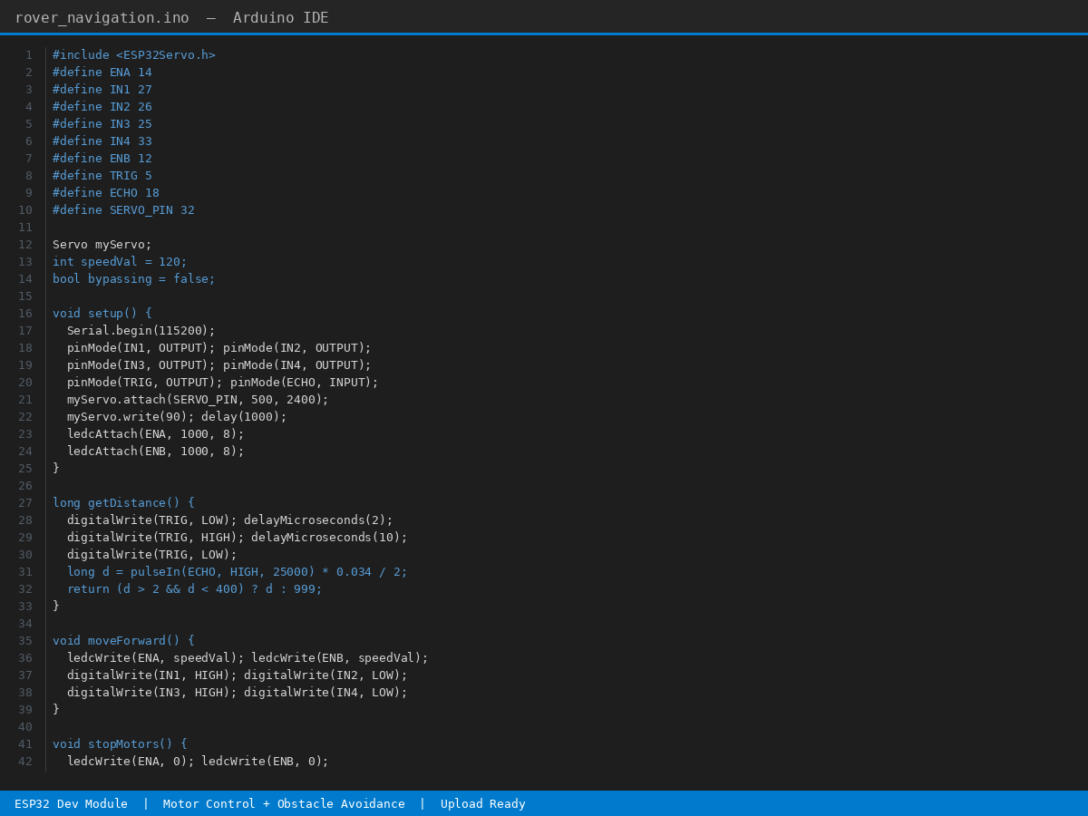
Coding & Integration
Arduino IDE used for programming
Motor control logic implemented
Sensor integration completed successfully
Decision-making algorithm added

Slide 7
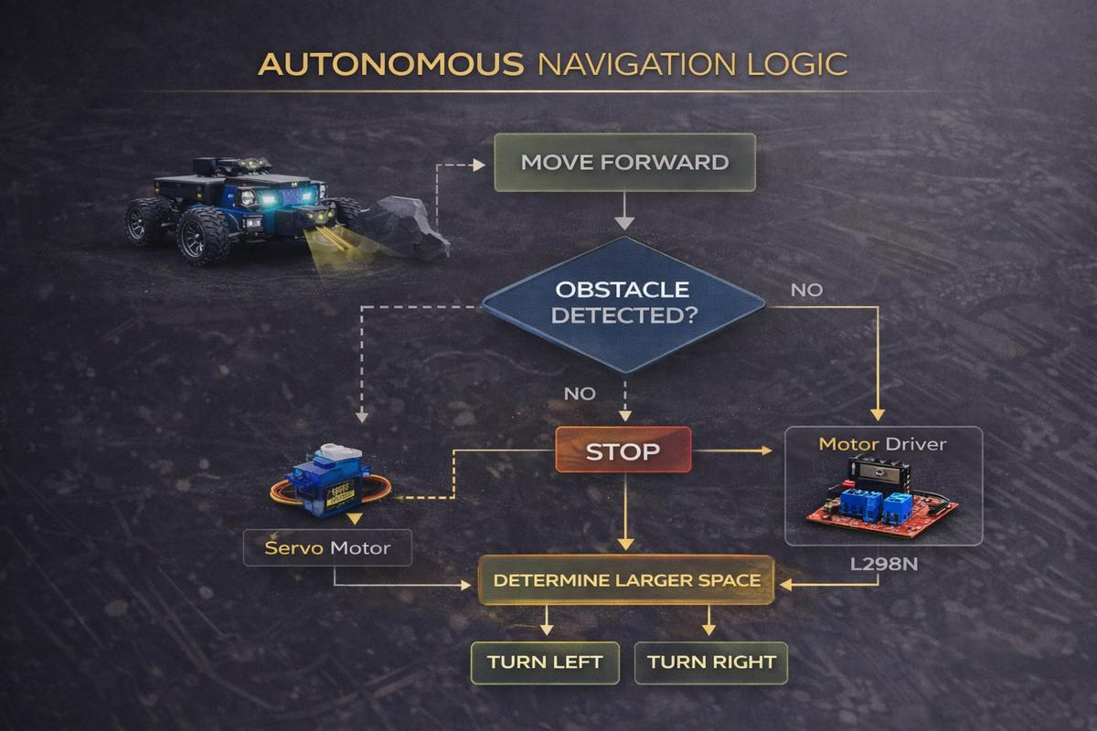

Slide 8
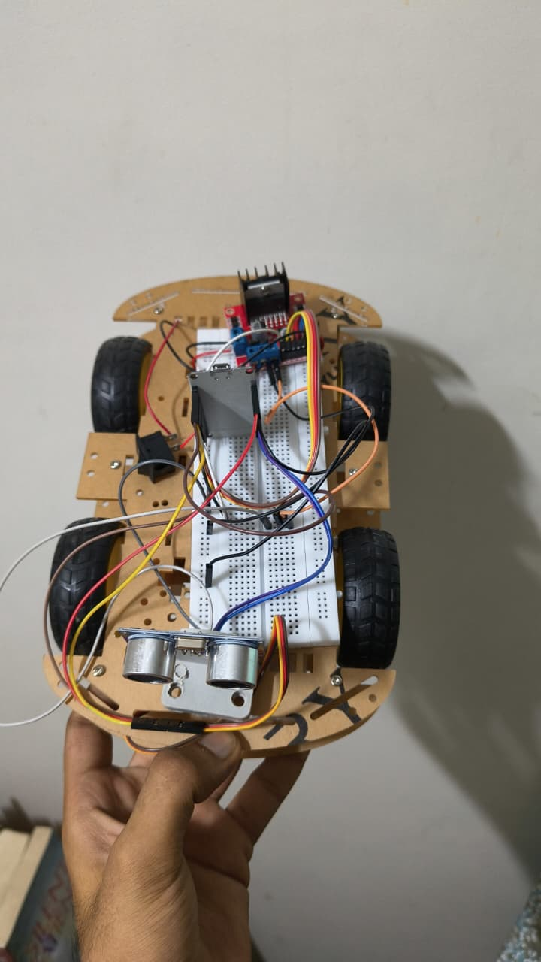
Software Demo
Python-based ML detection system
Detects weed, animal, and insect
Demonstrates intelligent decision-making
Implemented and tested on laptop

Slide 9
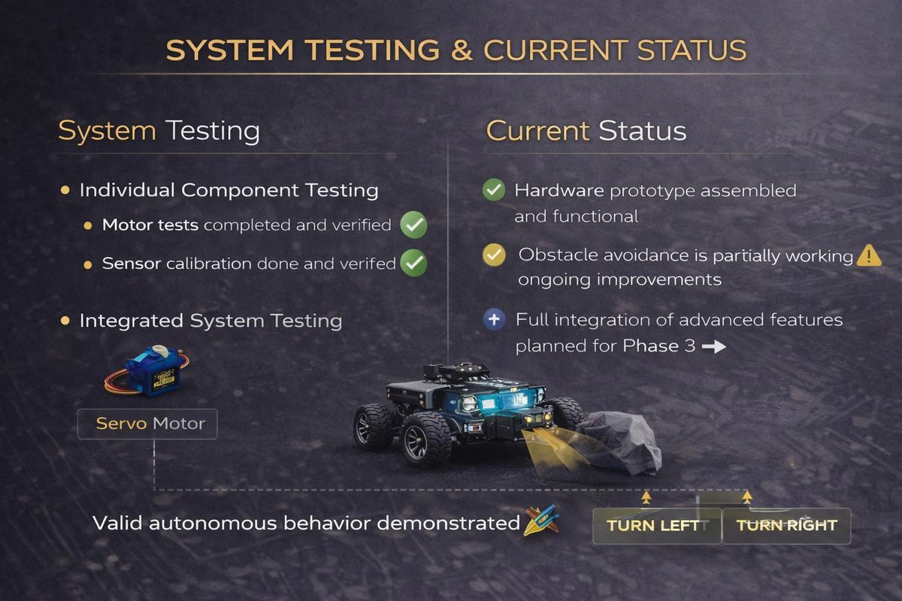
System Testing
Motor testing completed successfully
Sensor testing verified properly
Integrated system testing performed
Navigation logic validated in test environment

Slide 10
Challenges & Solutions
Challenges
Solutions
Learning robotics concepts
Hardware-software issues
Sensor accuracy limits
Power supply instability
Used ESP32 for performance
Simplified navigation logic
Used simulation for testing
Modular system approach

Slide 11
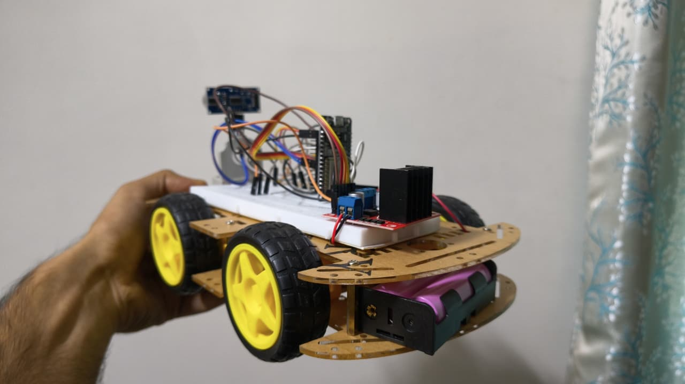
Current Status
Prototype assembled successfully
Movement achieved properly
Obstacle avoidance partially working
ML demo implemented on laptop
Strong foundation for Phase 3

Slide 12
Phase 2 Outcome
Working Prototype
Basic Navigation
Phase 3 Ready
Successfully developed and assembled
Autonomous movement system achieved
Strong foundation for next phase
Phase 2 successfully demonstrates a working rover prototype with autonomous navigation capabilities.

Slide 13
Thank You
Autonomous Agriculture Rover — Phase 2
INDUS INSTITUTE OF TECHNOLOGY AND ENGINEERING

